Slide 1
Supermarket data Analysis
By Sayan Pramanik

Slide 2
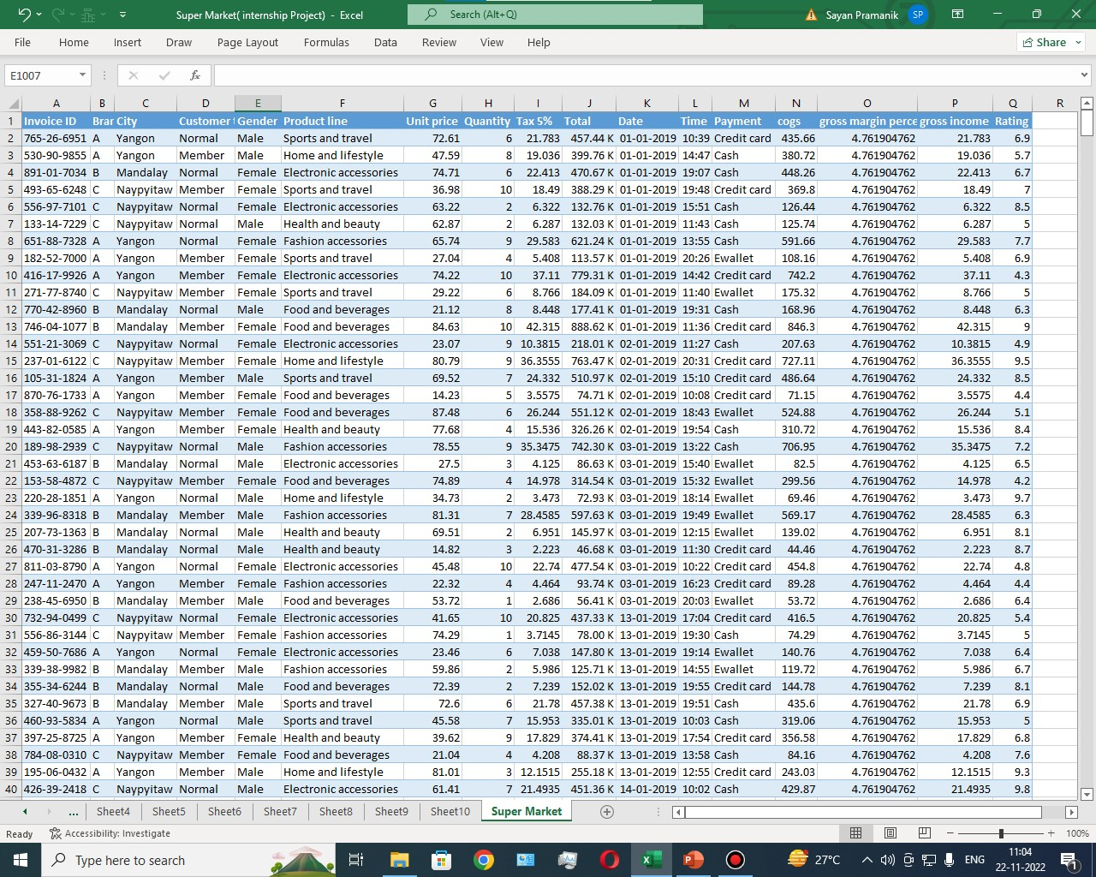

Slide 3
Objective
Owner of supermarket wants to Increase sales in next financial year by
Adding quality product that will attract more customers
Understanding customer interest to run more relevant ad campaigns
Bringing new and existing customer to loyalty program

Slide 4
Payment Method
34% of our customer still using cash while paying

Slide 5
Gender Wise Product sales
As you can see our male
customers are buying more
Health and beauty product
compare to our female
customer
And female customers are buying more Food and
Beverages compare to
male customers

Slide 6
Product bought by member & non-member
Our members are buying
more Food and Beverages
compare to our normal
customer
And our normal customer
are Purchasing more
Electronic accessories
compare to our members

Slide 7
Quarterly Sales
All products Are generating
Good sales in1st quarter
Compare to other
Products, Fashion
Accessories are generating
good sales in 3rd quarter

Slide 8
Final Insights
34% of our customers are still using cash while paying. According to a survey
customer spend up to 80% more using a card or any online method other than
cash. Company can offer cashback and new offers to convince cash users to
shift into digital payments.
Most of our members are female customer.
Most of our members are buying food and beverages And non member are
Purchasing more electronic products.
In order to bring new customer to our loyalty program we can give them
cashback or different offers. Example we can show them that we are giving
additional benefit or offer in our Electronic equipment for our members.
1st quarter is our top selling quarter, in 1st quarter Electronic Accessories are our
Highest selling Product. But overall in a year Food and beverages are our top
selling product.
In different cities there are different peak hours and just before peak hour we can
display our offers just outside of the mall in order to attract more customer.

